Slide 1
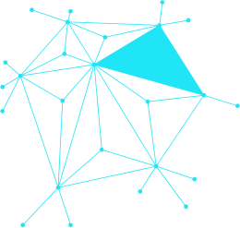


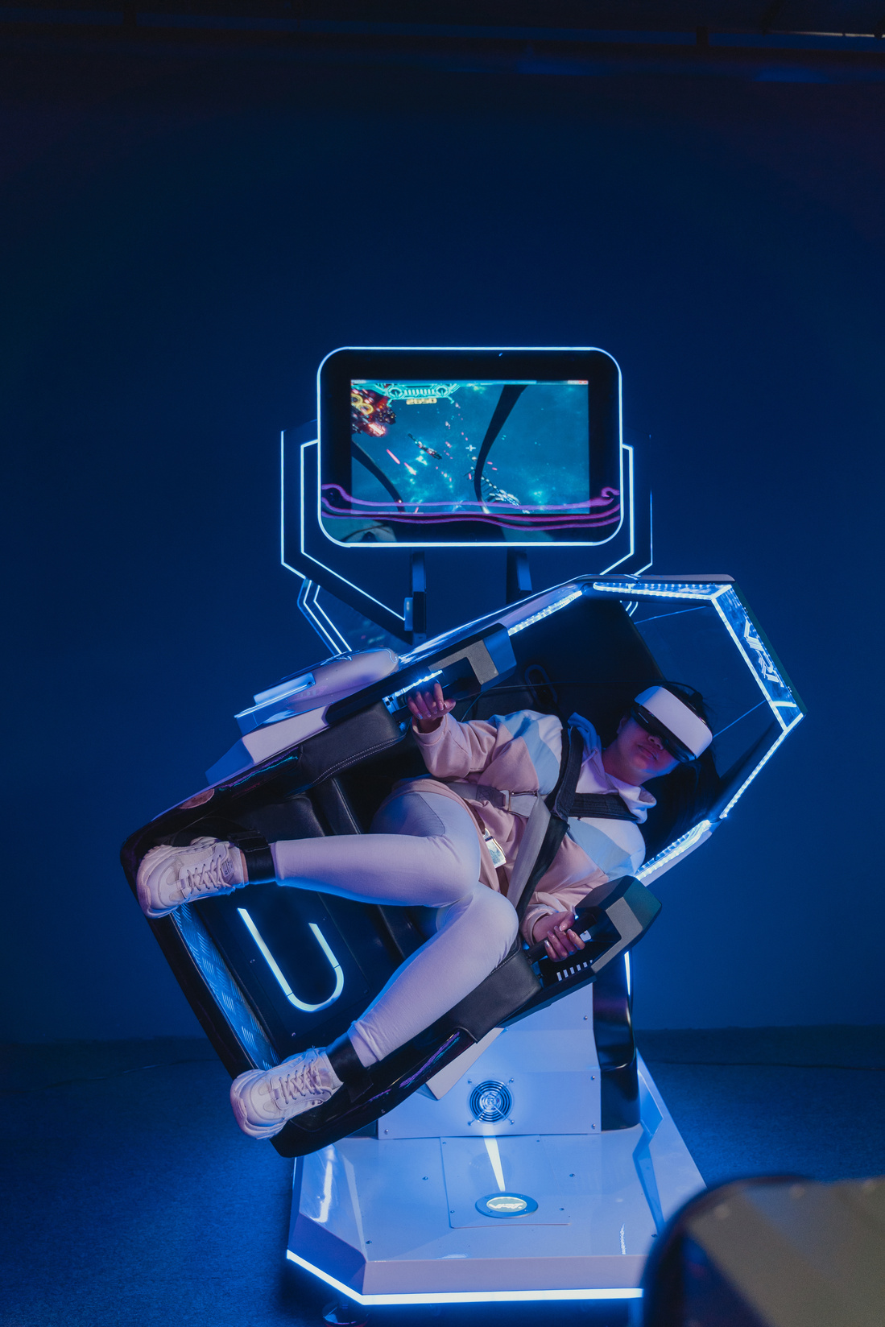

AUTOMATIC IMAGE CAPTIONING
Group Number : 04
Pavaki Maithili : MT/AI/10020/26
Rishika Ranjan : MT/AI/10021/26
Page 01

Slide 2
Table of Contents
  Realworld Problem
  Research Questions & Hypotheses
  Dataset Description
  Methodology
  Experimental Setup & Results
  Interesting/Failure Cases
  Conclusion, Limitations & Future Improvement
Page 02

Slide 3
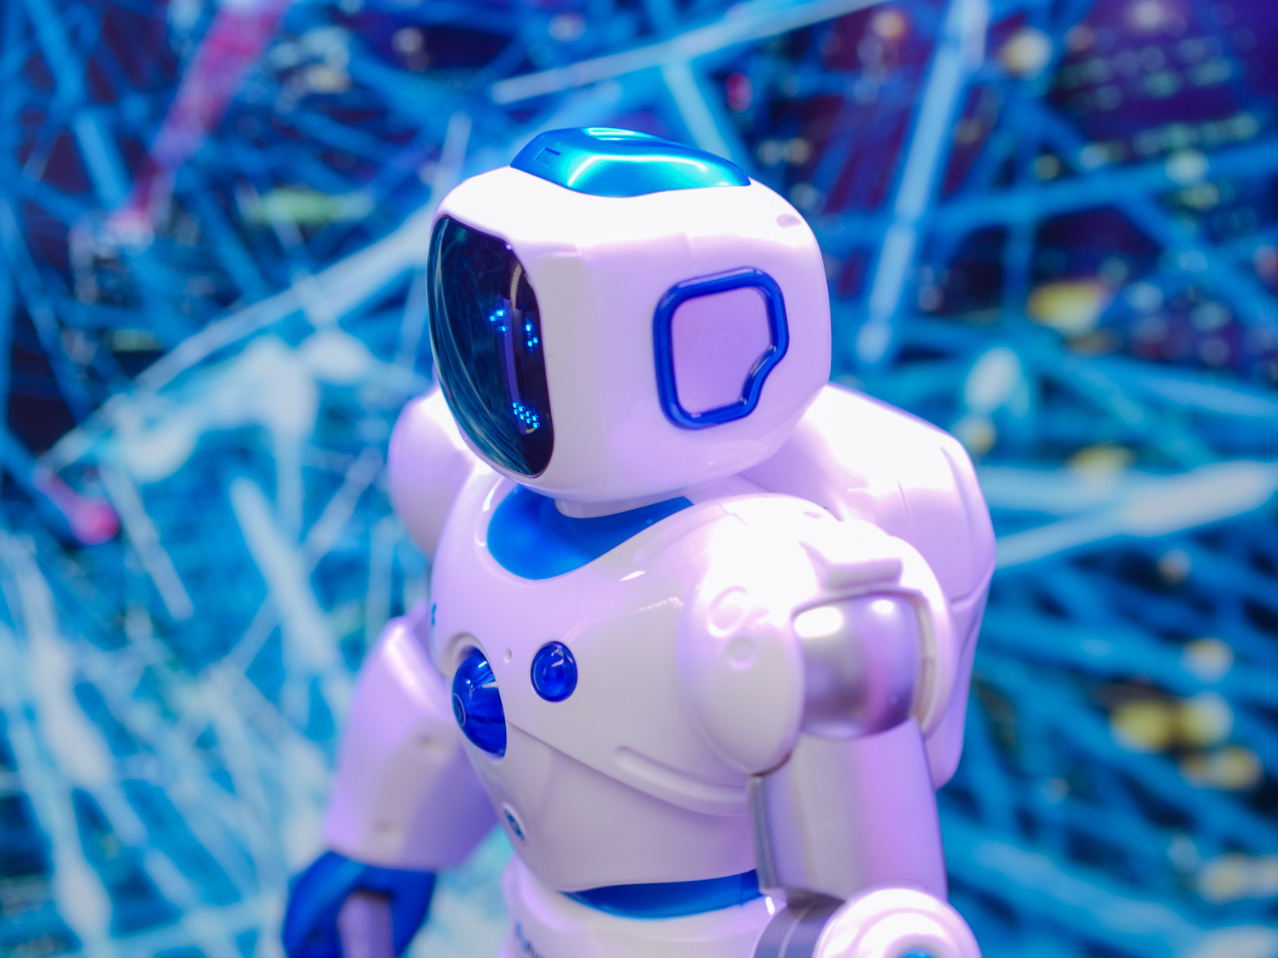
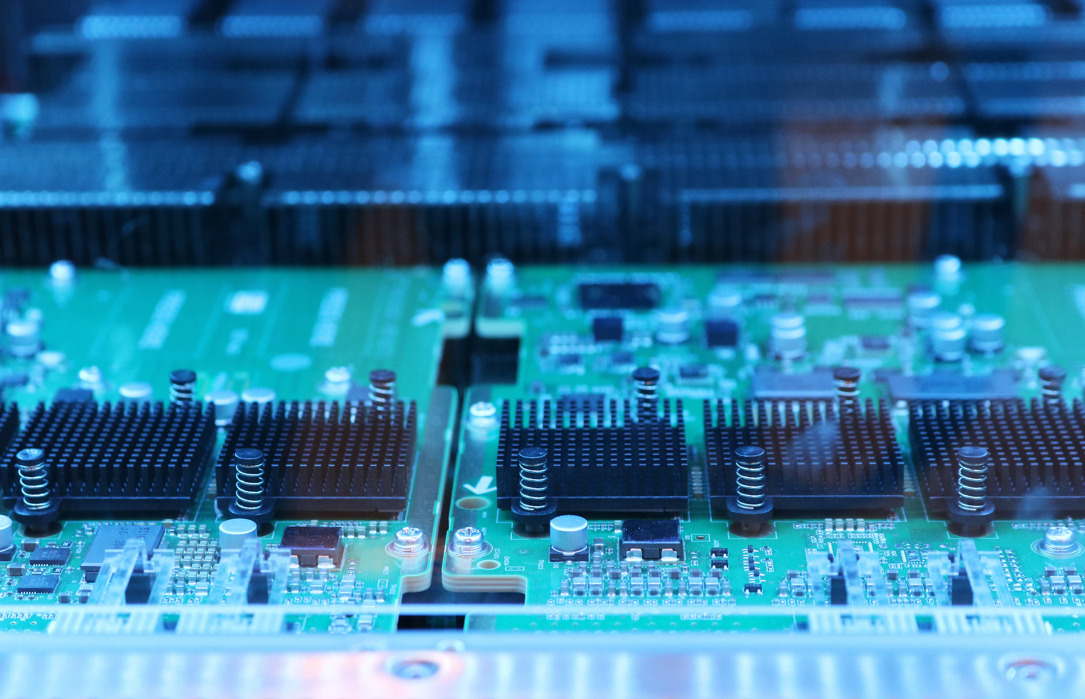
REALWORLD PROBLEM
DIFFICULTY FOR VISUALLY IMPAIRED PEOPLE:
Visually impaired people often find it difficult to identify objects, recognize people’s activities or understand the surrounding in an image. So,they need to depend on others to describe visual content . To solve this problem automatic image captioning was used which automatically generate meaningful textual description of images and using screen reader they can understand the content independently.
TIME-CONSUMING MANUAL ANNOTATION:
Manually describing important details of an image and adding suitable labels can take a lot of time and effort, especially when dealing with thousands of images. So, automatic image captioning can be used to reduce manual work by generating description quickly which helps in saving time and managing the images more efficiently.
Page 03

Slide 4

CHALLANGES IN IMAGES RETRIEVAL
Finding a particular image among thousand sof pictures can be time consuming, especially when images do not have proper labels or specifications. Image captioning helps by automatically creating meaningful descriptions for images. This makes it easier for people to search for the pictures they need, keep their image collections organized, and find the right image quickly without wasting too much time.
LIMITED CONTEXTUAL UNDERSTANDING
Traditional image recognition systems can identify objects in an image, such as people, vehicles, or animals, but may not understand what is happening in the scene. For example, a system might recognize a person and a bicycle but fail to explain that the person is riding the bicycle on road. Image captioning helps overcome this limitation by describing the objects, their activities, and their relationships in simple sentences. This provides a clearer understanding of the entire image.
Page 04

Slide 5
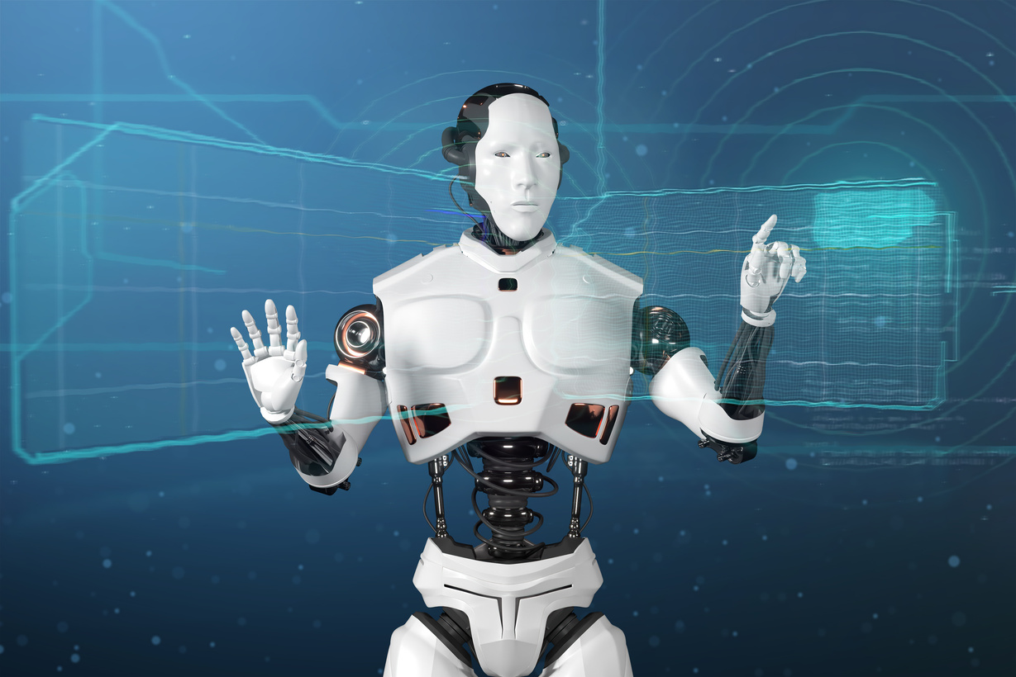
OBJECTIVE:
The objective of this project is to develop an automatic image captioning system which will convert visual information into meaningful language using CNN for visual feature extraction, RNN for sequential caption generation, and a Transformer based self-attention mechanism to capture contextual relationships between image features and words. The system will generate meaningful appropriate captions that describe objects, their activities and interactions within an image. The performance of this system will be evaluated using word-level accuracy, precision, recall and f1-score, along with Bleu, Meteor, and Rouge-L metrics to assess caption quality. It aims to improve image accessibility for visually impaired people and also support applications such as automated image description and image retrieval.
Page 05

Slide 6
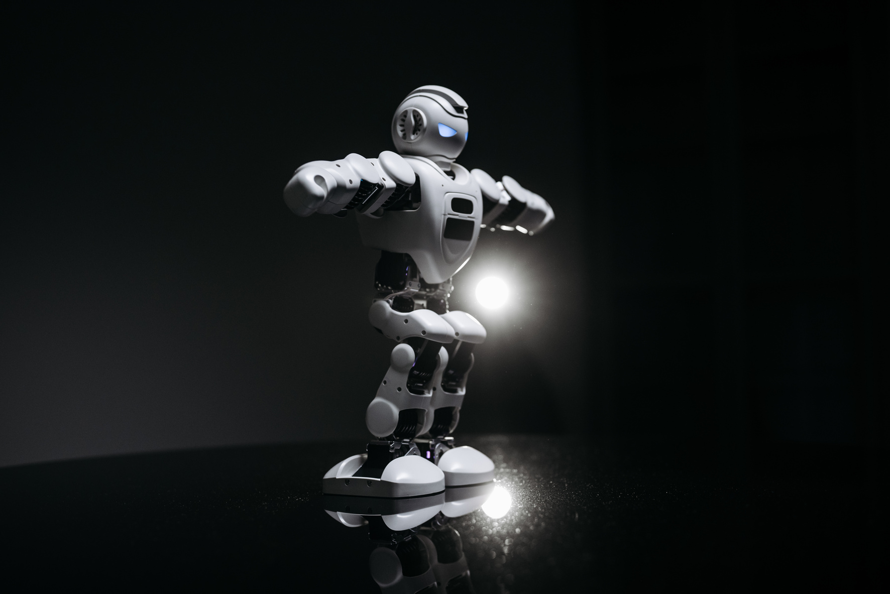
RESEARCH QUESTION AND HYPOTHESIS
RESEARCH QUESTIONS FOR AUTOMATIC IMAGE CAPTIONING :
1. Object Recognition: How well can the model recognize objects in an image and understand what they are doing or how they relate to each other?
2. Caption Accuracy: How well can a deep learning model summarize an image in a meaningful and logical way?
3. Caption Quality: How does the attention mechanism help the model generate more accurate and related captions?
4. Time Efficiency: How much time and effort can automatic image captioning save compared to writing image descriptions manually?
5. Accessibility: How can spontaneous image captioning help visually impaired people understand the content of images more easily?
Page 06

Slide 7
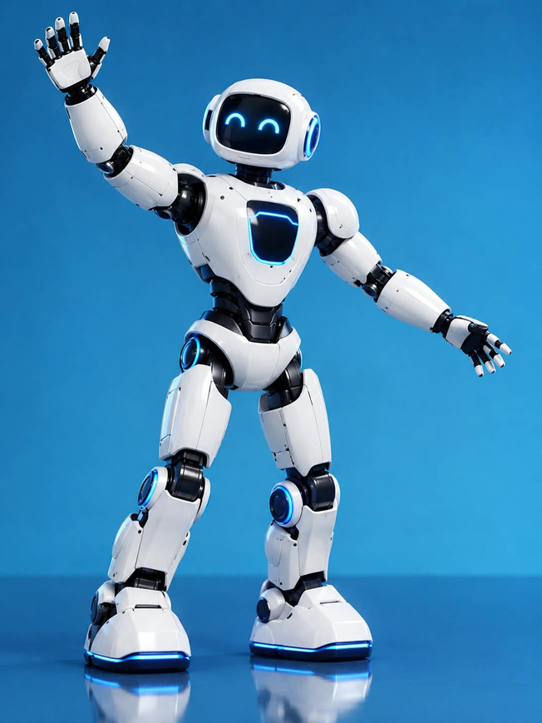
HYPOTHESES FOR AUTOMATIC IMAGE CAPTIONING :
  Research Hypothesis: It is a CNN-based feature extraction model combined with a RNN decoder and using Bahdanau attention mechanism which can generate meaningful and relevant image captions by focusing on important visual features.
  Null Hypothesis: The proposed CNN-RNN model with Bahdanau attention does not generate relevant captions for some input images.
  Accessibility Hypothesis: Automatically generated captions helps visually impaired people in understanding image content more easily through meaningful textual descriptions.
  Efficient Hypothesis: Automatic image captioning can reduce the time and effort required to organize large collection of images.
Page 07

Slide 8
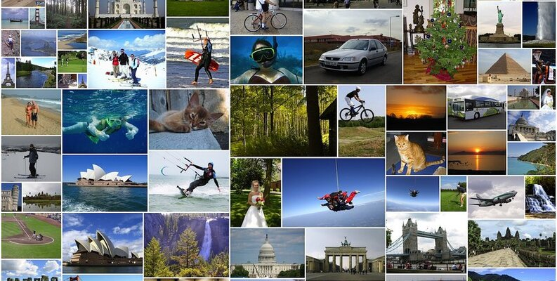
DATASET DESCRIPTION
In our automatic image captioning project, we used the Flickr8K dataset, downloaded from Kaggle. It contains around 8,000 images, and each image has five captions written by humans to describe what is happening in the picture.
The dataset includes different types of images, such as animals, people, nature, and daily activities. These images and their captions help our model learn how to understand the content of a picture and describe it in simple, meaningful words. This allows the model to generate captions automatically, making images easier to understand and more accessible to everyone.
Page 08

Slide 9
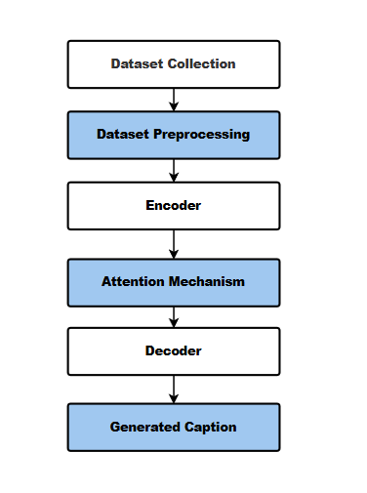
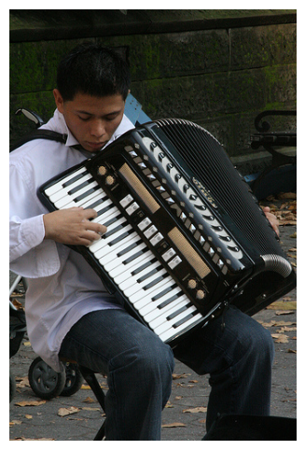
METHODOLOGY
“A man in a white shirt and jeans playing an accordion”
Fig 1 : Flowchart of Automatic Image Captioning
Page 09

Slide 10
METHODOLOGY OVERVIEW :
Dataset collection : Flickr8k dataset is used in this project., which contains images paired with human-written descriptions and it includes 5 captions per image.
Data Preprocessing : Prepare the images and captions for training by resizing and normalizing images for Inception V3 image classifier and remove unnecessary words or symbols from captions and convert words into numerical representations.
Feature Extraction : An encoder converts an image into numerical features that the next part of the model can understand. For that , we have used Inception V3, a pretrained CNN which is used for image classification and feature extraction.
Caption generation using RNN and Bahdanau Attention : A RNN decoder is used to generate captions one word at a time. The Bahdanau Attention mechanism helps in focusing on the most relevant image features while predicting each word.
Page 10

Slide 11
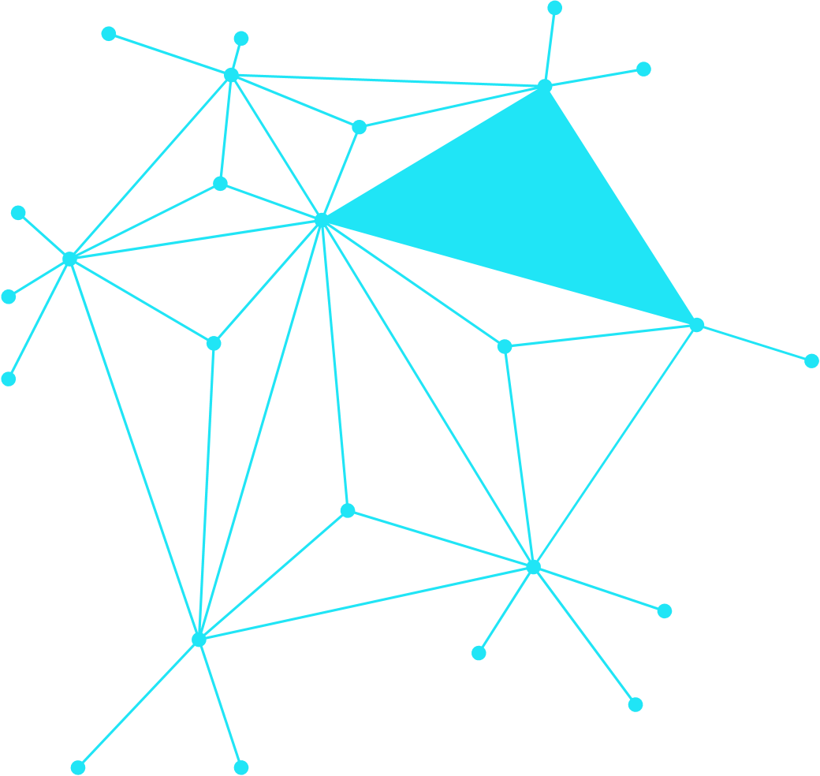

Model Training : Model is trained using this dataset so that it learns to generate captions accurately. The dataset was divided into 80:20 ratio. 80% used for training the model and 20% percent used for validating the model and adjusting the model parameters accordingly.
Caption geeration and Evaluation : Test the trained model using new images and evaluate the genrated captions using BLEU, METEOR, ROUGE-L Scores , Word-level accuracy, Precision, Recall and F1-score.
Page 11

Slide 12
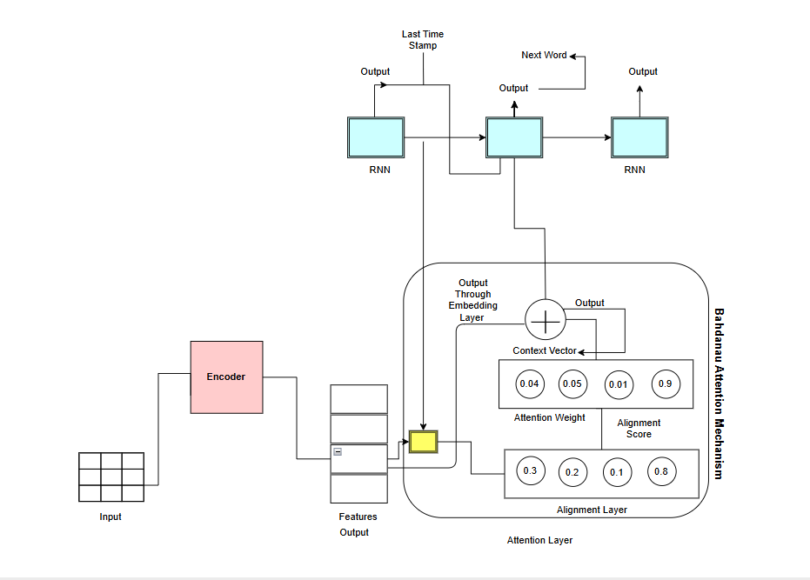
EXPERIMENTAL SETUP AND RESULTS
Fig 2 : Encoder-Decoder Architecture
Page 12

Slide 13
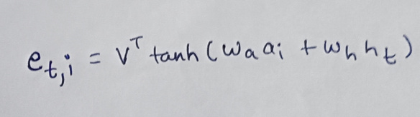
EXPLANATION
  Images are given to the encoder which gradually transforms raw pixels into a more meaningful numerical representation. In image captioning, using Inception V3, a pre trained CNN model it can extract features from the image.
  Encoder outputs the hidden states and the decoder current hidden state are passed to the alignment layer
  which will compute the alignment score .
  In additive attention, alignment score is calculated as
  Tanh activation function is used to introduce non-linearity into the alignment layer, allowing the model to learn complex relationships.
  The alignment layer compares the decoder’s state with each image region features for calculating the alignment score. Alignment score tells the decoder on which part of encoder’s output it needs to pay attention.
  To convert the raw alignment score to normalized attention weights we need to apply softmax layer. Attention weights tells us how much importance each image region should receive.
  The attention weight and hidden states of encoder will be added together to produce context vector. The model combines image features, giving importance to region with higher weights.
  The decoder uses this visual context to generate the next word using embedding layer(RNN layer), the output from decoder at last time stamp and context vector will be used by decoder for generating the next word, so this is how Bahdanau self attention works and the caption is generated as an output for the given input image.
Page 13

Slide 14
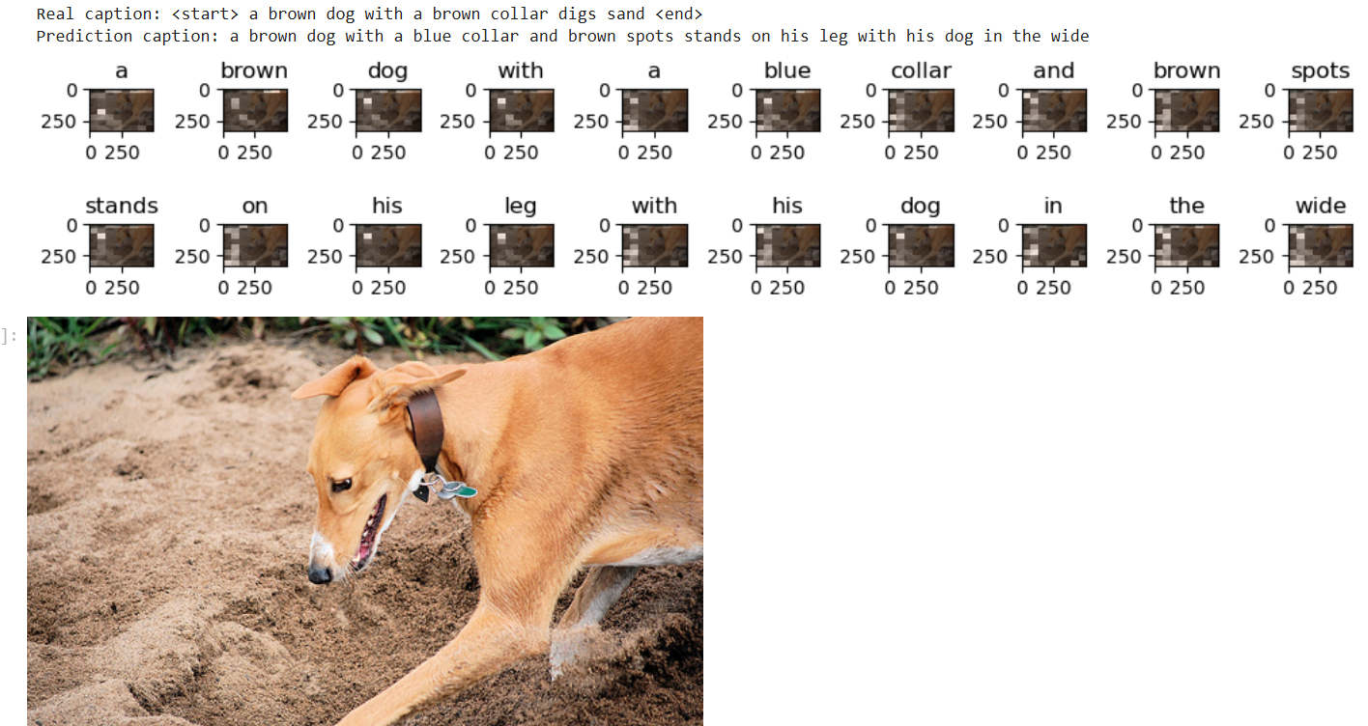
RESULTS
The final result of encoder-decoder architecture:
Fig 3: Final result
Page 14

Slide 15
A loss function was computed to compute the loss between real and predicted captions. The loss has been computed word to word so word-level accuracy is checked for all the first five images. Besides, word-level accuracy we have also evaluated different types of performance metrics which includes,
  BLEU-1, BLEU-2, BLEU-3, BLEU-4 which measures the overlap of generated and reference caption word sequences.
  METEOR which evaluates caption similarity using word matching and related linguistic information.
  ROUGE-L which measures similarity based on longest common word sequence.
  Word-level Accuracy which measures normalized word-level similarity.
  Exact Match Accuracy which measures proportion of generated caption that exactly match the reference caption.
  Precision, Recall and F1-score which measures word-overlap performance between generated and reference captions.
Page 15

Slide 16
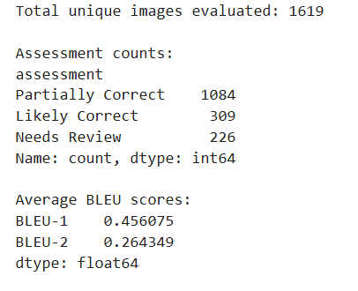
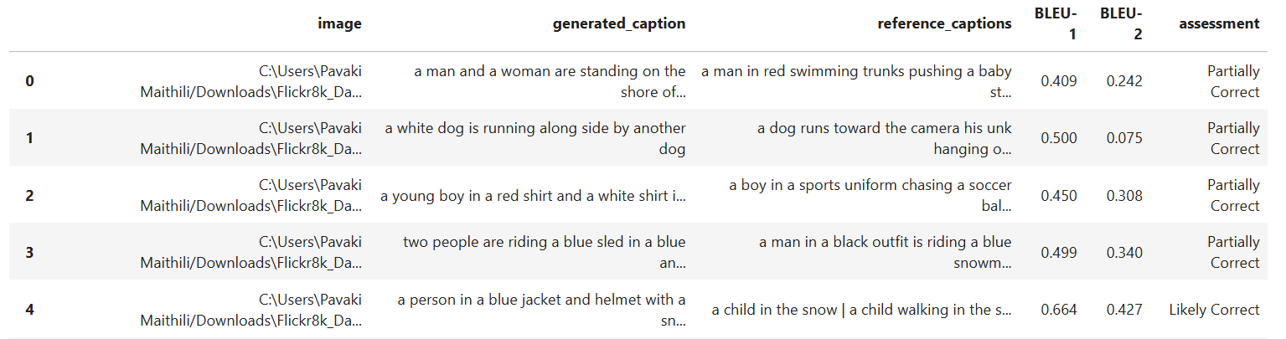
Fig 4: Bleu Score Assessment
Page 16

Slide 17
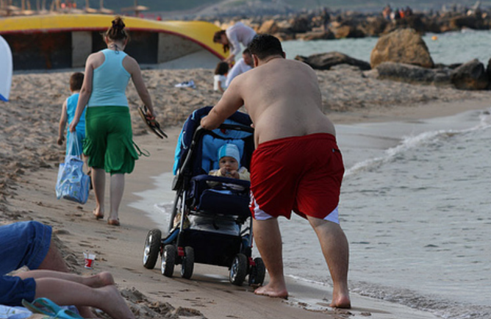
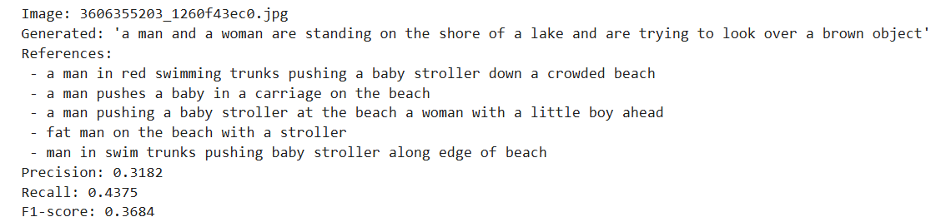

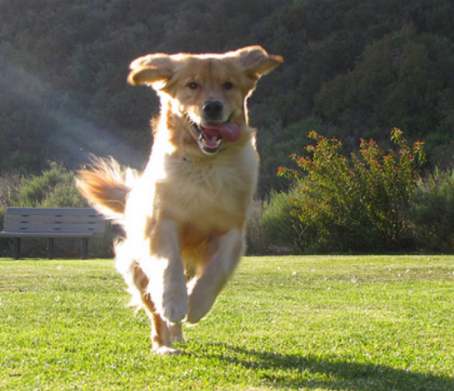
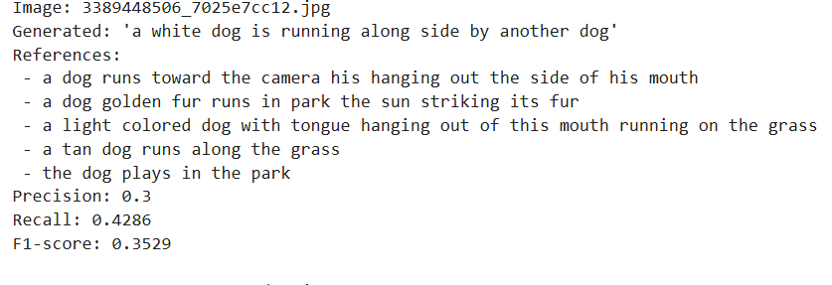
Input Images Result/Outcome
(Generated captions, precision, recall and f1-score)
1.
Fig 5
2.
Fig 6
Page 17

Slide 18
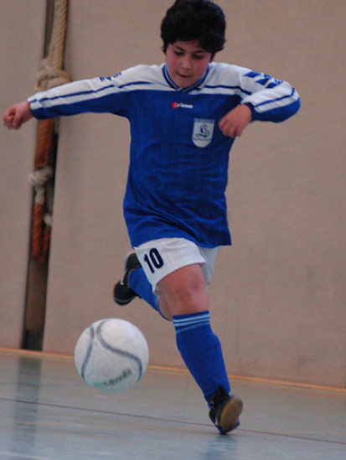
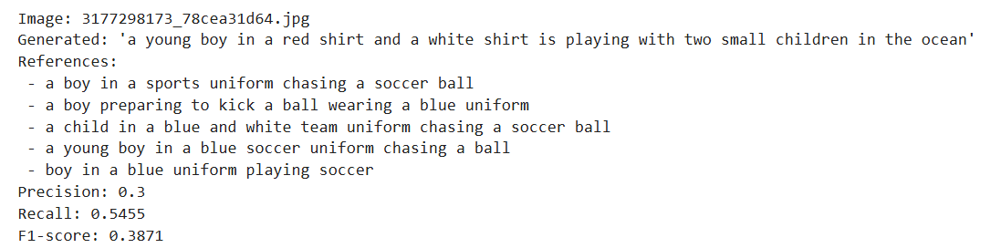
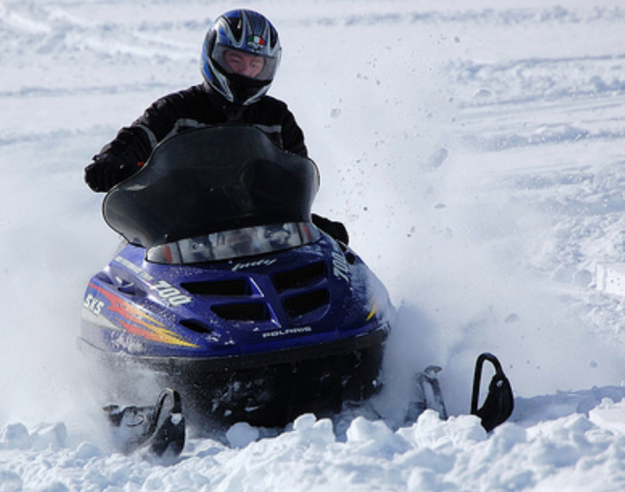
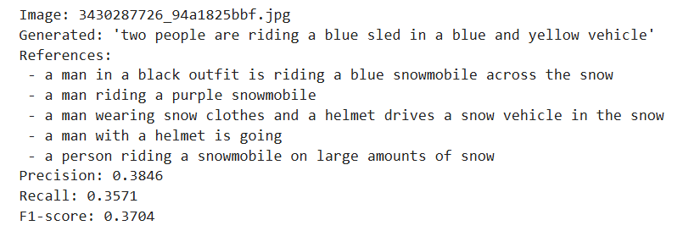
3.
Fig 7
4.
Fig 8
Page 18

Slide 19
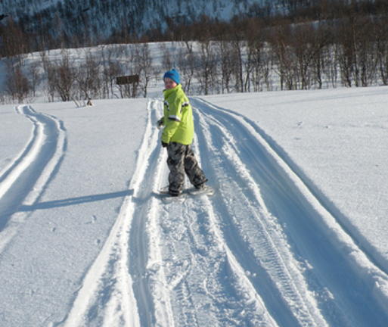
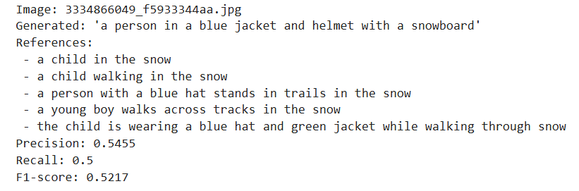
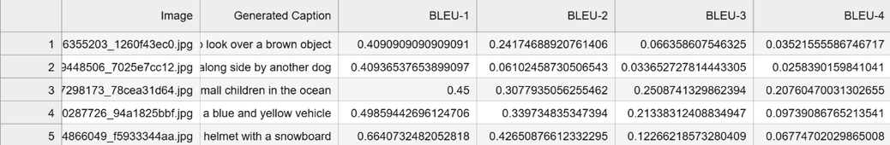
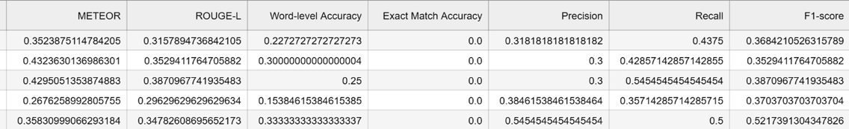
5.
Fig 9
FIg 10: First 5 images performance metrics
Page 19

Slide 20
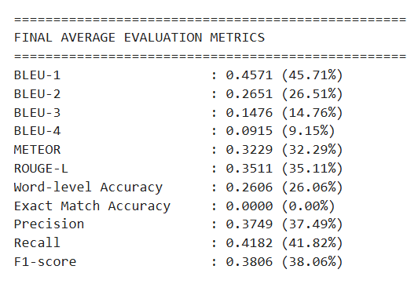
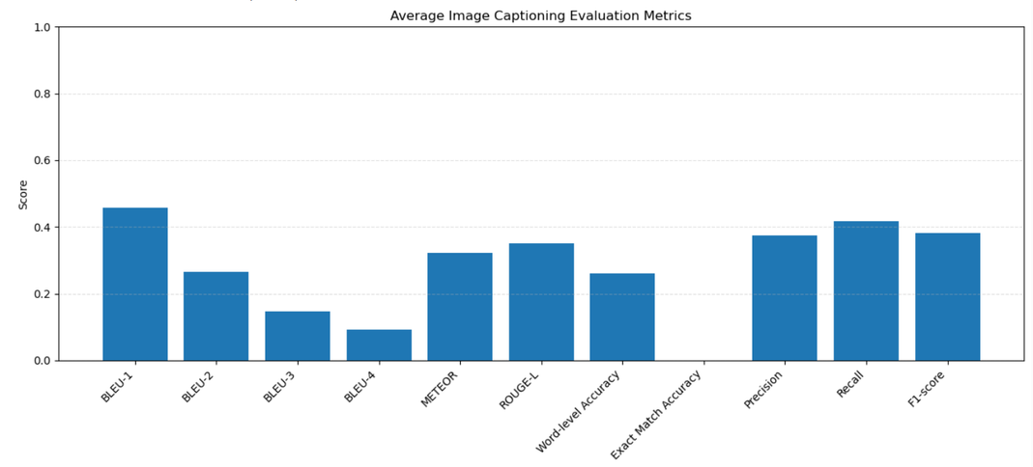
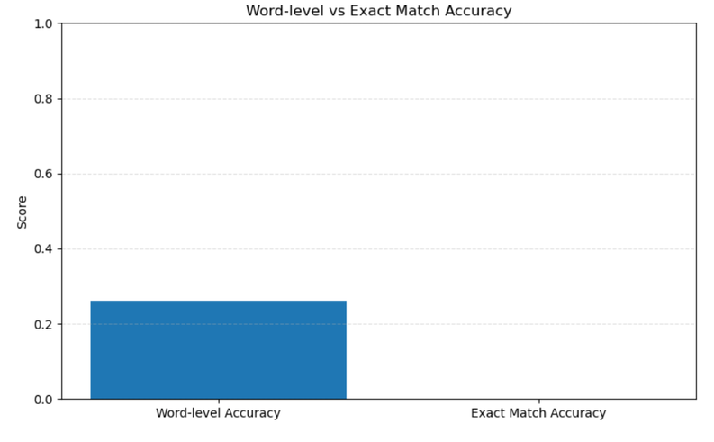
Fig 11: Final Average evaluation metrics
Fig 12: Bar Chart Representation of evaluation metrics
Fig 13: Bar chart represenattion of Word level accuracy vs Exact match accuracy
Page 20

Slide 21
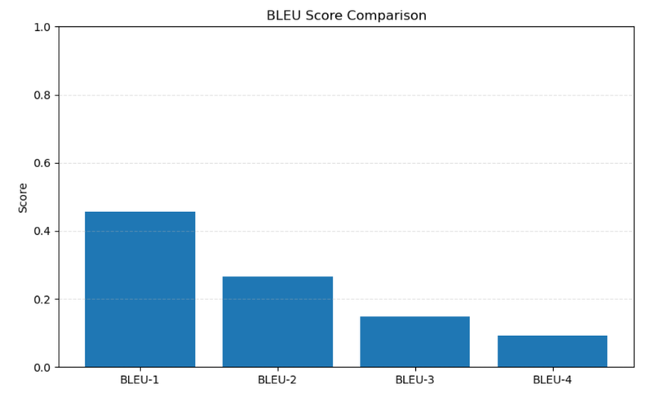
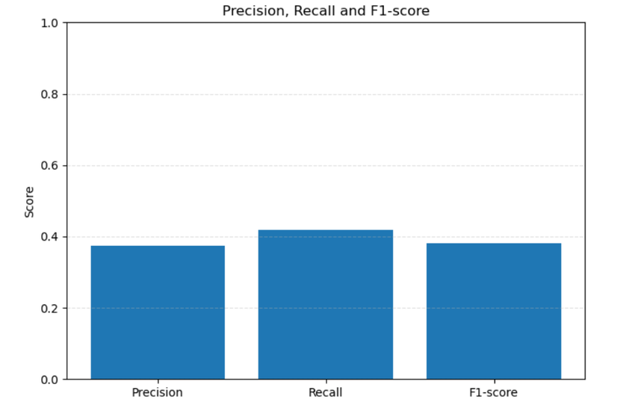
Fig 14: Bar chart represenattion of BLEU score comparison
Fig 15: Bar chart representation of Precision, Recall, F1-Score
Page 21

Slide 22
INTERESTING/FAILURE CASES
Failure Cases:
Case 1: Incorrect Action Recognition
Actual scene: A man in red swimming shorts is pushing a baby stroller along a beach, while a woman and a young boy walk ahead.
Generated Caption: “A man and a woman are standing on the shore of a lake and are trying to look over a brown object.”
Problem: The model fails to identify the baby stroller and main action of pushing it. It also incorrectly describes the beach as lake shore.
Reason: CNN encoder may not extract sufficient visual details, while the attention mechanism and RNN decoder may fail to associate the objects with their actions.
Case 2: Severe Object and Attribute Misidentification
Actual Scene: A man riding a purple snowmobile.
Generated Caption: “Two people are riding a blue shed in a blue and yellow vehicle.”
Problem: The model hallucinates the number of people and completely misidentifies the primary object and its attributes.
Reaon: Cnn encoder likely failed to capture the distinct geometric structure og the snowmobile, causing the attention mechanism to segment the scene poorly.
Page 22

Slide 23
Interesting Cases:
Case 1: Correct scene identification with minor errors
Actual scene: A child walking along tracks in the snow.
Generated Caption: “A person in a blue jacket and helmet with a snowboard”.
Reference Caption: “A young boy walks across tracks in the snow”.
Model Performance: It correctly identifies the person and the general snowy environment, but incorrectly predicts clothing color and winter-sports equipment.
Observation: The model recognizes the overall scene but struggles with fine-grained visual details and accurate action description.
Case 2: Correct action recognition with object confusion
Actual scene: A golden-colored dog running toward the camera on a grassy field.
Generated caption: “A white dog is running alongside another dog”.
Reference caption: “A tan dog runs along the grass”.
Model performance: It correctly identifies a dog running, but incorrectly describes its color and also predict another dog that is not visible.
Observation: The model recognizes the main object and action but struggles with accurate color recognition and object counting.
Page 23

Slide 24
CONCLUSION, LIMITATIONS, AND FUTURE IMPROVEMENTS
CONCLUSION :
Automatic image captioning uses deep learning to generate meaningful descriptions of images. In our project, we used the Flickr8K dataset from Kaggle, containing approximately 8,000 images, each with five human-written captions.
We used a CNN encoder, an RNN decoder, and an attention mechanism to extract visual features and generate captions word by word. This project can help reduce manual effort, improve image accessibility for visually impaired people, and make searching and organizing images easier.
Overall, automatic image captioning has promising applications in accessibility, education, digital media, and image retrieval. However, the quality of generated captions depends on the dataset, model architecture, training process, and complexity of the images. Further improvements are needed to make the captions more accurate, descriptive, and reliable.
Page 24

Slide 25
LIMITATIONS :
  Limited Dataset Size : The Flickr8K dataset contains approximately 8,000 images, which is relatively small for training complex deep learning models. As a result, the model may not learn enough visual patterns to describe every type of image accurately. It may perform well on familiar scenes but struggle with unusual objects or situations.
  Difficulty Understanding Context : The model may identify individual objects but fail to understand the complete situation. For example, it might recognize a person and a bicycle without correctly describing the person's activity or the relationship between them.
  Repetitive and Generic Captions : The model may generate similar captions for different images, such as “A person is standing outside.” Such captions may be grammatically correct but may not describe the unique details of a particular image.
  Limitations of Attention Mechanisms : Attention mechanisms help the model focus on relevant visual features, but they do not guarantee complete scene understanding. The model may assign attention to irrelevant regions or overlook small but important details.
  Evaluation Challenges : Automatic evaluation metrics such as BLEU and ROUGE compare generated captions with reference captions. However, a caption may be correct even if it uses different words from the reference. Therefore, these metrics may not fully capture the meaning, usefulness, or accuracy of a generated caption.
Page 25

Slide 26
FUTURE IMPROVEMENTS :
  Use Larger and More Diverse Datasets : Our future work can use larger datasets, such as Flickr30k or MS COCO, containing more images and captions. A more diverse dataset can help the model learn a wider range of objects, activities, backgrounds, and real-world situations.
  Improve CNN-Based Feature Extraction : More advanced image encoders, such as EfficientNet, ResNet, or Vision Transformer (ViT), can be explored to extract richer visual features. Better feature extraction may help the model recognize objects and understand complex scenes more effectively.
  Generate More Natural and Detailed Captions : Future improvements can focus on producing captions that are grammatically correct, informative, and less repetitive. The system should describe not only the objects in an image but also their activities and relationships when these details are visually supported.
  Improve Evaluation Methods : In addition to BLEU, ROUGE, and METEOR future work can use metrics such as CIDEr, and SPICE. Human evaluation can also help determine whether captions are accurate, understandable, relevant, and useful in real-world situations.
  Support Multiple Languages : Currently, our model is generating captions in only one language. Future work could support multiple languages, making the system useful to people from different linguistic backgrounds.
Page 26

Slide 27


